Slide 1
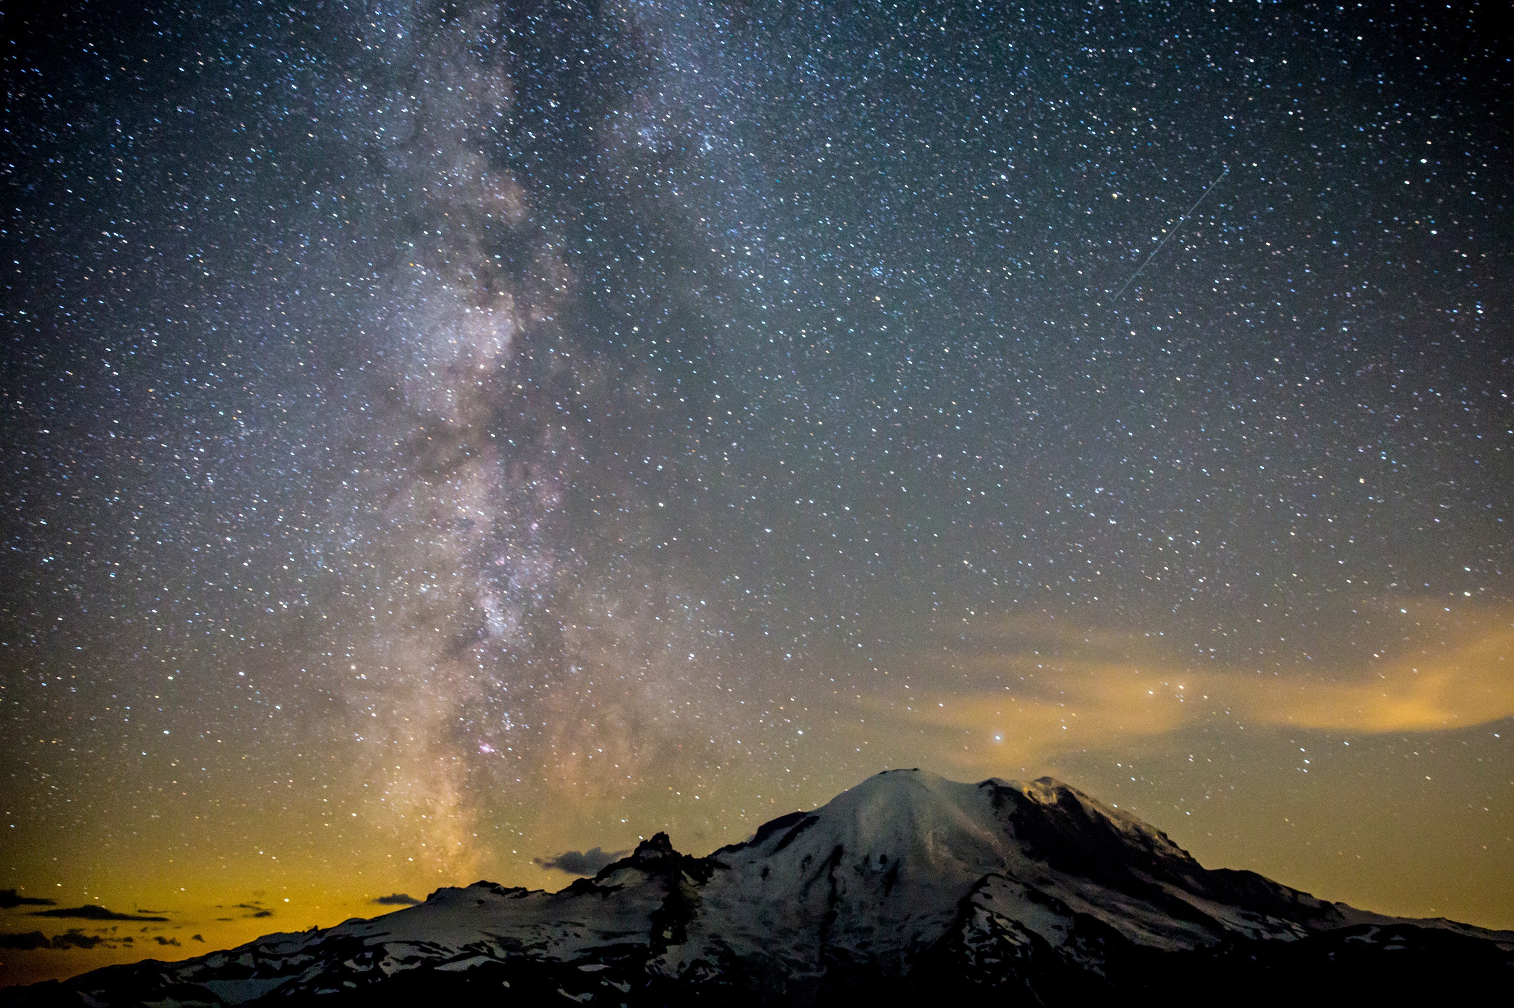

Modeling of
Aeroservoelastic Systems
Anthony Su
11/30/2023

Slide 2
Agenda
Overview
FEM & GVT
State-Space Modeling
Wind Tunnel Testing
Model Tuning & Optimization
Results & Conclusion

Slide 3
Overview
AEROSERVO-
ELASTICITY
MODELING
MARGE
Structural Dynamics
Aerodynamics
Controls
Surrogate system for control design
System identification
Model for Aeroelastic Response to Gust Excitation
Notes:
Aeroservoelasticity
structural dynamics, aerodynamics, and controls
important because energy-efficient aircraft have long, slender wings which are flexible
the most flexible wings must actively counteract bending and twisting in real-time
MLA, GLA, and flutter suppression
Modeling
<insert>
MARGE
MARGE is the article is modeled and tested here
short for Model for Aeroelastic Response to Gust Excitation
it is

Slide 4
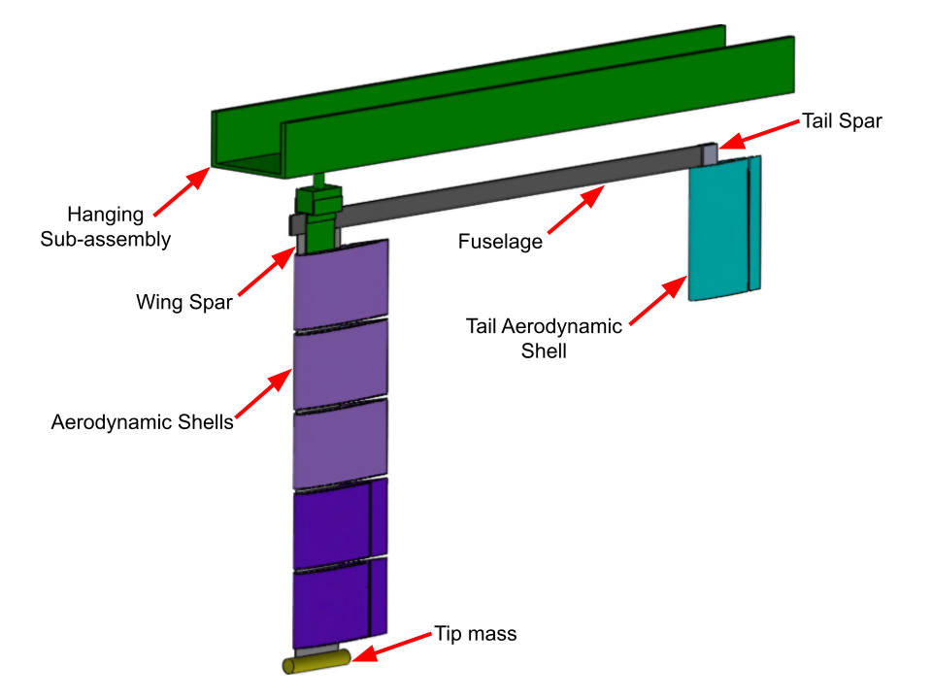
Overview
MARGE
Model for Aeroelastic Response to Gust Excitation
Low-cost
Highly flexible
Rotates freely in pitch

Slide 5
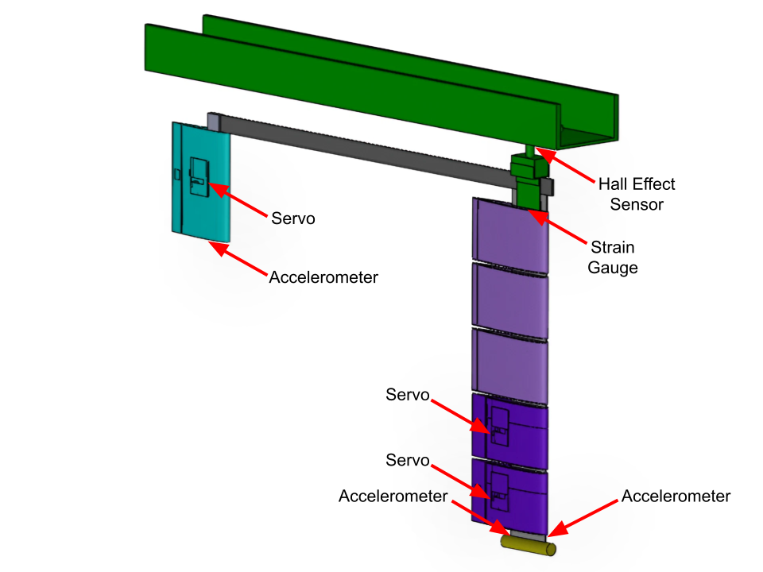
Overview
MARGE
Model for Aeroelastic Response to Gust Excitation
Low-cost
Highly flexible
Rotates freely in pitch
5 on-board sensors
3 on-board actuators

Slide 6
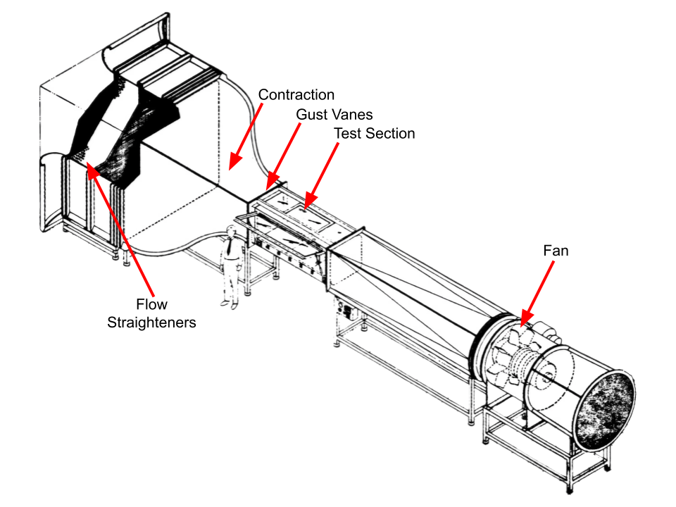
Overview
MARGE
Model for Aeroelastic Response to Gust Excitation
Low-cost
Highly flexible
Rotates freely in pitch
5 on-board sensors
3 on-board actuators
3x3 Wind Tunnel
twin controllable gust vanes

Slide 7
References
[1]
[2]
[3]
[4]
[5]
[6]

Slide 8


ENCODE
SANS

Slide 9
FONT GUIDE
Headings:
ENCODE SANS NORMAL BLACK, ALL CAPS
Alternate headlines and subheads:
UNI SANS BOOK, ALL CAPS
Bodies: Open sans and Open sans bold

Slide 10
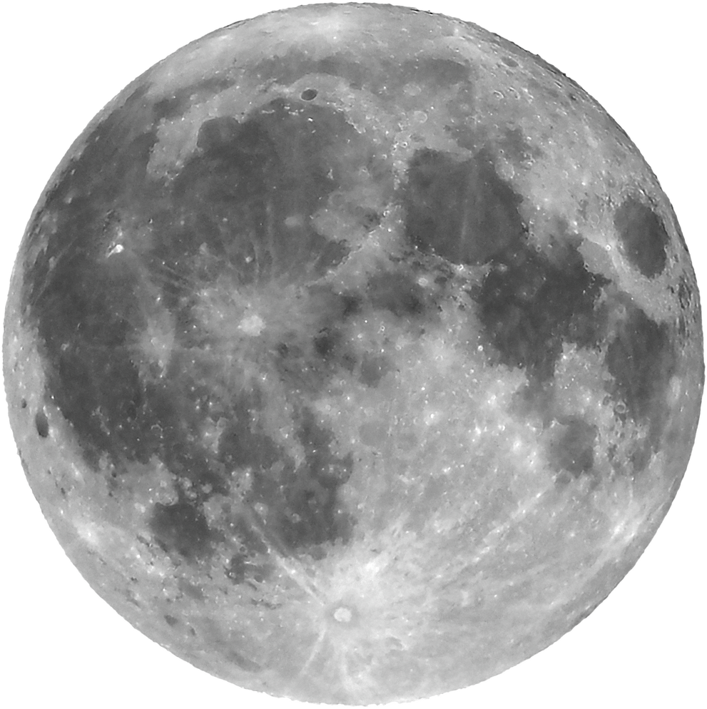
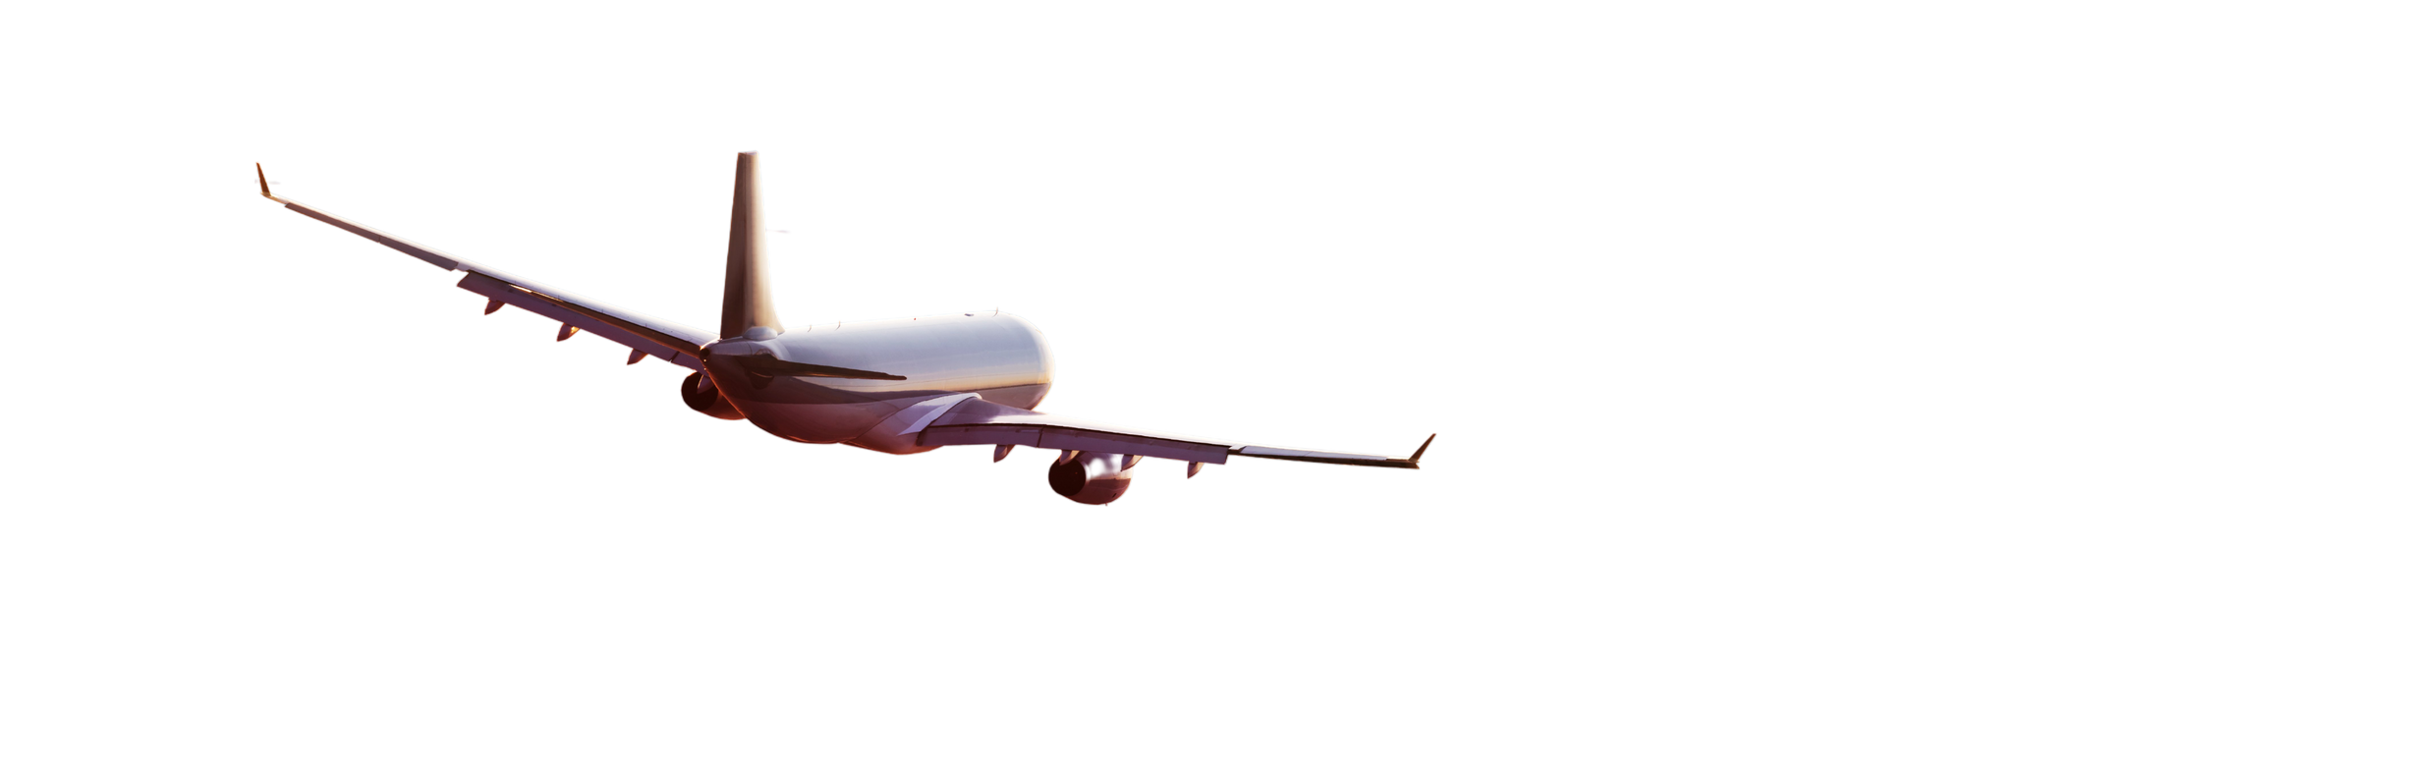
1
Open sans regular body
ENCODE
SANS
2
Or open sans bold body
UNI SANS
(SUBHEADING)

Slide 11
ENCODE SANS HEADING
UNI SANS SUBHEADING
87%
Briefly elaborate on what you want to discuss.
Briefly elaborate on what you want to discuss.

Slide 12
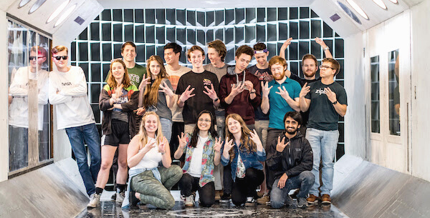
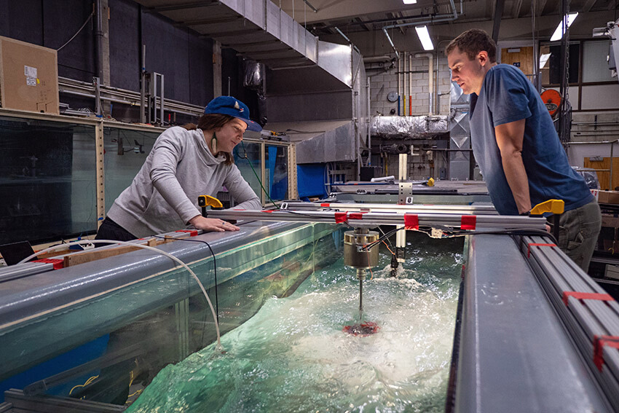
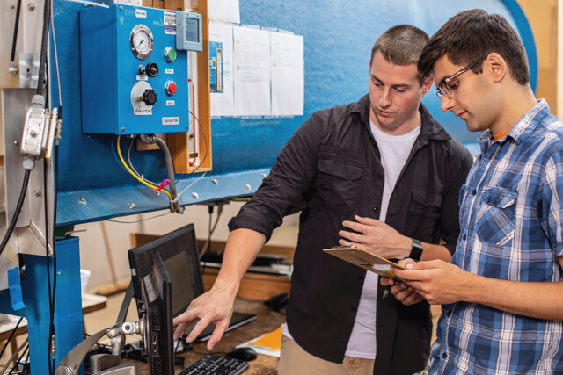
ENCODE SANS HEADING
Open sans body Open sans body Open sans body Open sans body Open sans body Open sans body Open sans body Open sans body Open sans body
1
2
3
Open sans body
Open sans body
Open sans body
Open sans body
Open sans body
Open sans body
Open sans body
Open sans body
Open sans body
Open sans body
Open sans body
Open sans body
Open sans body
Open sans body
Open sans body
Open sans body
Open sans body
Open sans body

Slide 13
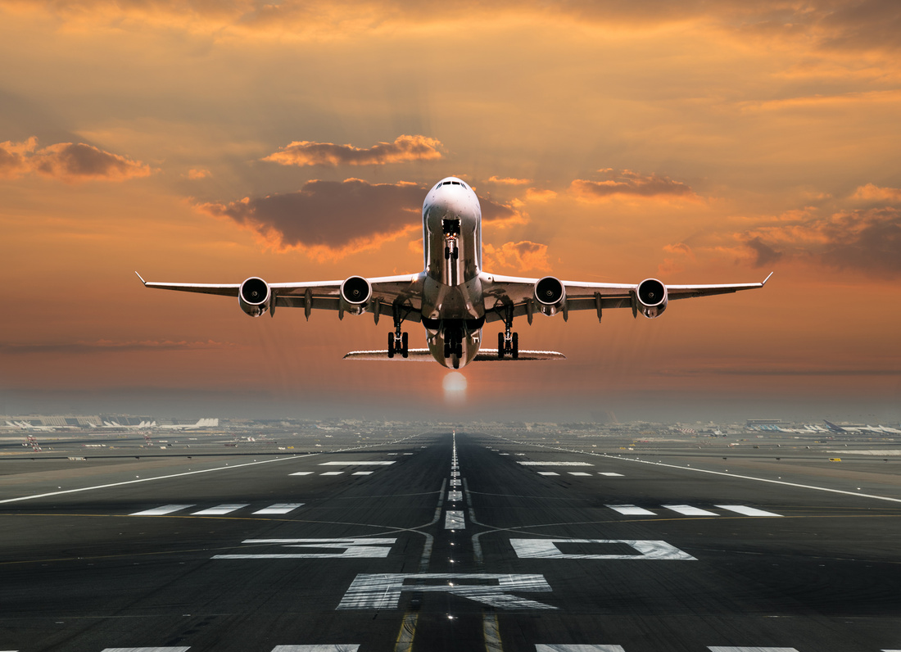
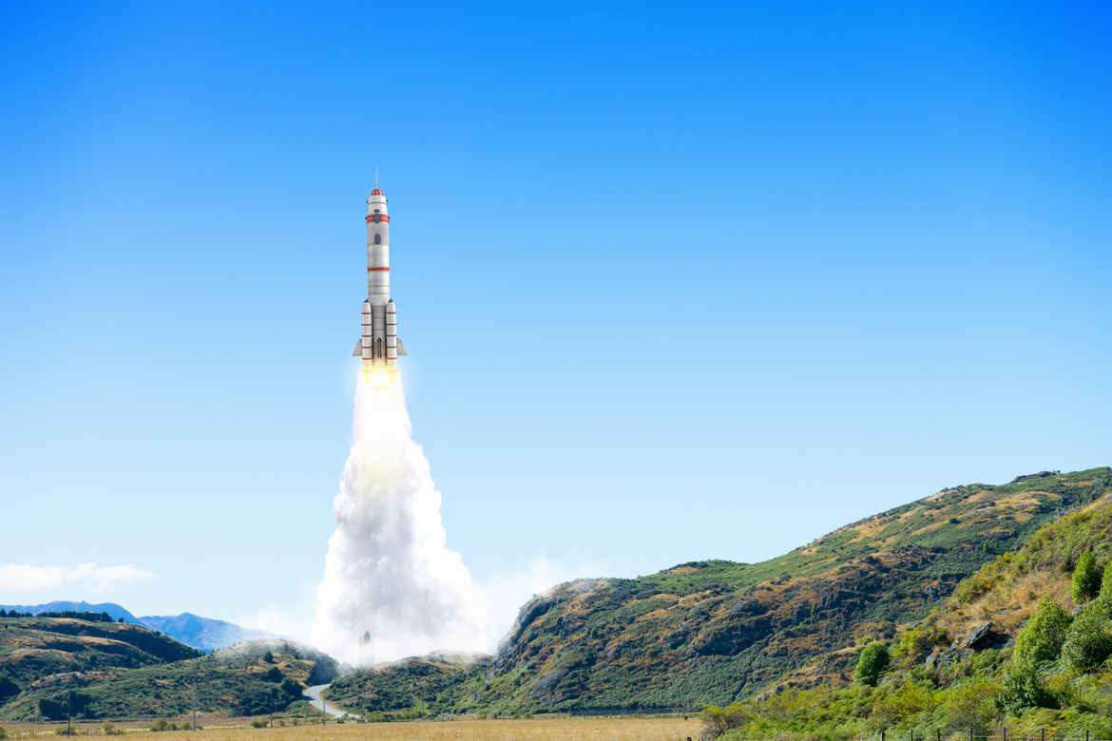
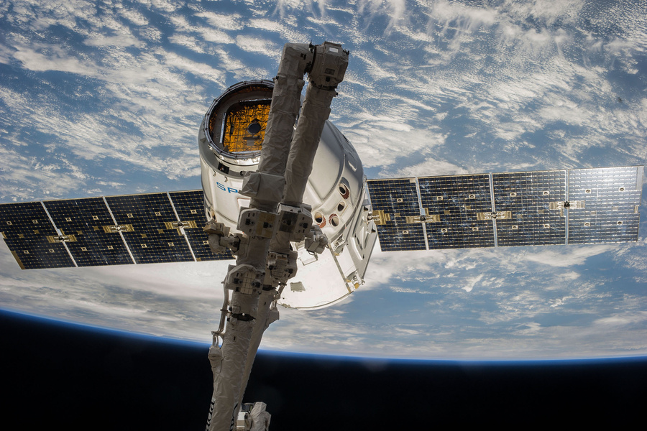
ENCODE SANS HEADING
Open sans body Open sans body Open sans body Open sans body Open sans body Open sans body Open sans body Open sans body
UNI SANS
UNI SANS
UNI SANS
Open sans body Open sans body Open sans body Open sans body Open sans body Open sans body
Open sans body Open sans body Open sans body Open sans body Open sans body Open sans body
Open sans body Open sans body Open sans body Open sans body Open sans body Open sans body

Slide 14

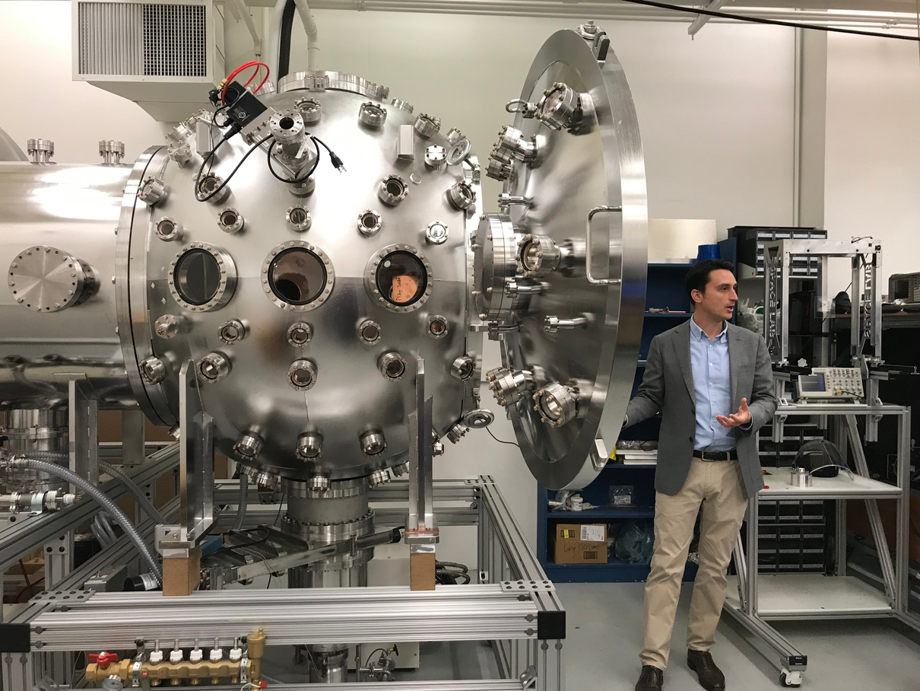
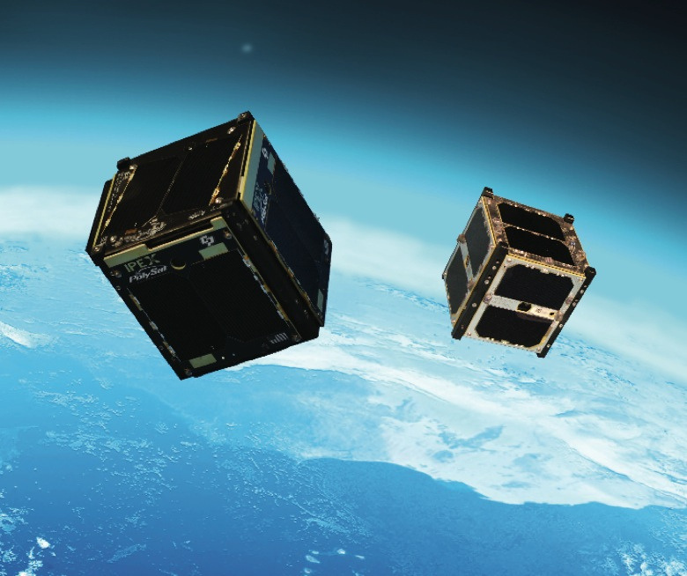

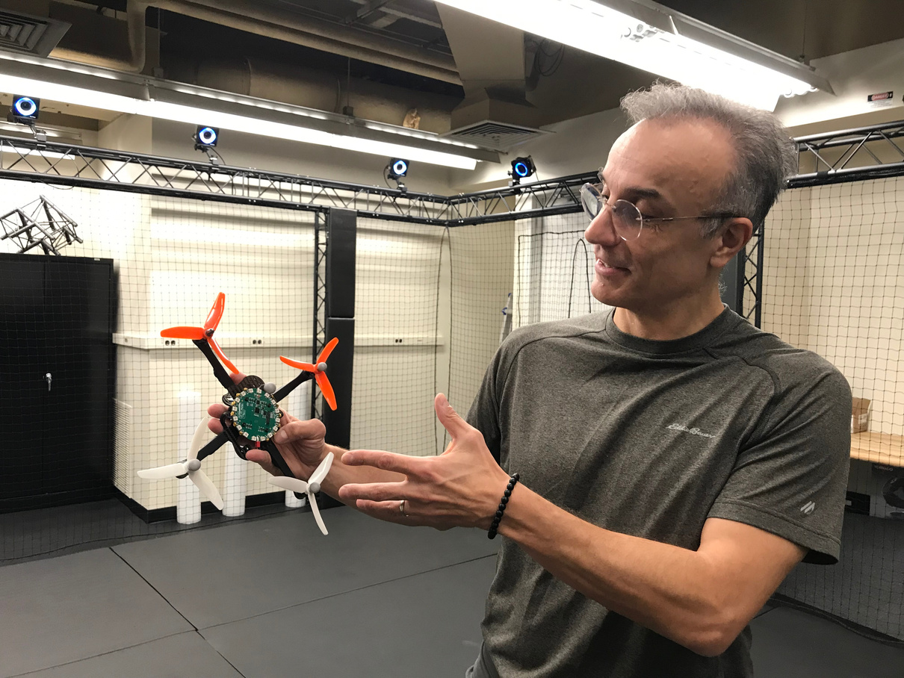
ENCODE SANS
UNI SANS SUBHEADING
Open sans body Open sans body Open sans body Open sans body Open sans body Open sans body Open sans body Open sans body Open sans body Open sans body
Open sans body Open sans body Open sans body Open sans body Open sans body Open sans body Open sans body Open sans body Open sans body Open sans body

Slide 15
break

Slide 16
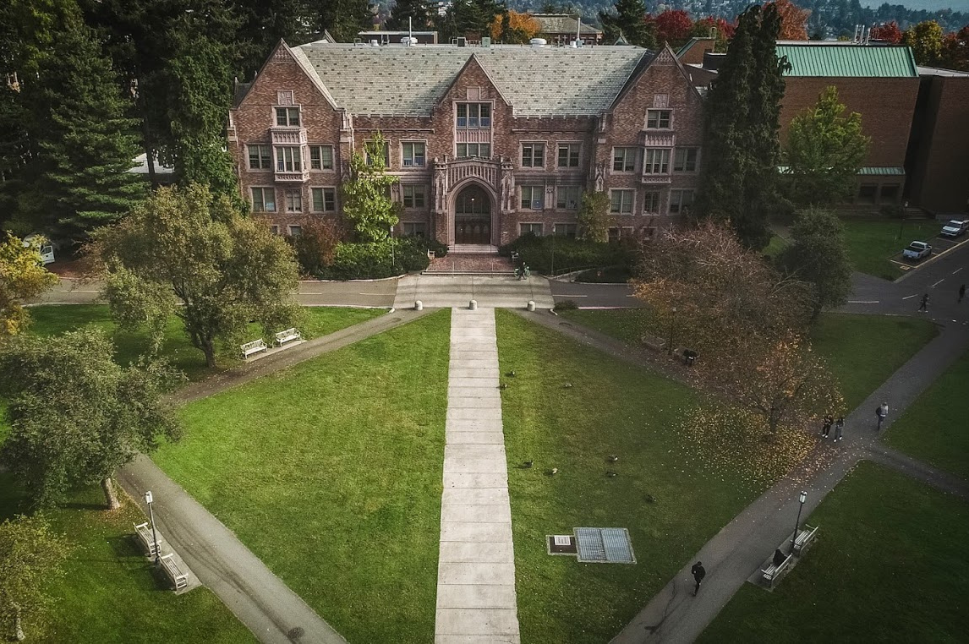
ENCODE SANS HEADING
UNI SANS SUBHEADING

Slide 17
01
UNI SANS
Open sans body Open sans body Open sans body Open sans body Open sans body Open sans body
UNI SANS
ENCODE
SANS
Open sans body Open sans body Open sans body Open sans body Open sans body Open sans body
UNI SANS
Open sans body Open sans body Open sans body Open sans body Open sans body Open sans body

Slide 18
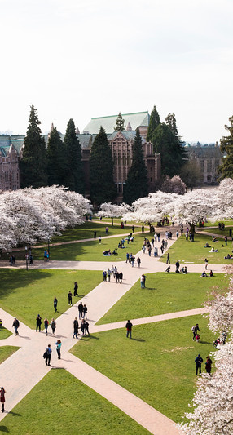
ENCODE SANS HEADING
02
UNI SANS SUBHEADING
Open sans body Open sans body Open sans body Open sans body Open sans body Open sans body Open sans body

Slide 19
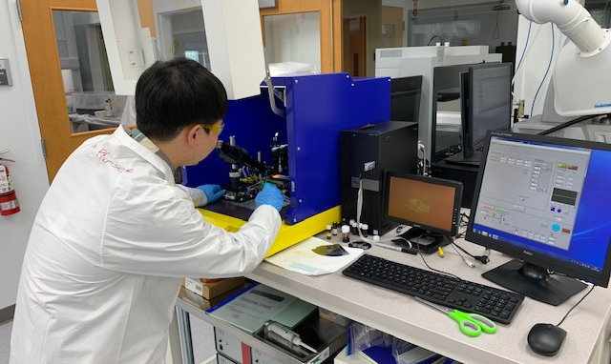
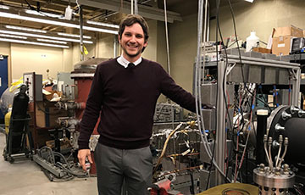
UNI SANS
Open sans body Open sans body Open sans body Open sans body Open sans body
UNI SANS
Open sans body Open sans body Open sans body Open sans body Open sans body

Slide 20
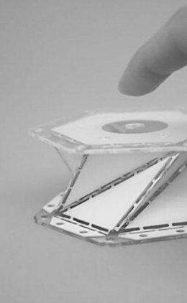
03
UNI SANS
Open sans body Open sans body Open sans body Open sans body
ENCODE SANS HEADING
UNI SANS
Open sans body Open sans body Open sans body Open sans body
UNI SANS
Open sans body Open sans body Open sans body Open sans body

Slide 21
break

Slide 22
ENCODE SANS
UNI SANS SUBHEADING
UW AERO AND ASTRO
pg 01 / 22

Slide 23
UNI SANS
UNI SANS
ENCODE SANS
Open sans
Open sans
Open sans
Open sans
Open sans
Open sans
Open sans
Open sans
Open sans
Open sans
03
07
08
09
11
13
14
15
16
17

Slide 24
UNI SANS
UNI SANS
OPEN SANS BOLD
Encode sans heading
UNI SANS SUBHEADING

Slide 25
UNI SANS
UNI SANS
OPEN SANS BOLD
Encode sans heading
UNI SANS SUBHEADING
Open sans body Open sans body Open sans body Open sans body Open sans body Open sans body Open sans body Open sans body Open sans body Open sans body Open sans body Open sans body Open sans body Open sans body Open sans body Open sans body Open sans body Open sans body

Slide 26
UNI SANS
UNI SANS
OPEN SANS BOLD
ENCODE SANS
Open sans body Open sans body Open sans body Open sans body Open sans body Open sans body Open sans body Open sans body Open sans body Open sans body Open sans body Open sans body Open sans body Open sans body Open sans body Open sans body Open sans body Open sans body Open sans body Open sans body Open sans body Open sans body Open sans body Open sans body Open sans body Open sans body Open sans body
Open sans body Open sans body Open sans body Open sans body Open sans body Open sans body Open sans body Open sans body Open sans body
ENCODE SANS
Open sans body Open sans body Open sans body Open sans body Open sans body Open sans body Open sans body Open sans body Open sans body

Slide 27
UNI SANS
UNI SANS
OPEN SANS BOLD
ENCODE SANS HEADING
UNI SANS
UNI SANS
UNI SANS

Slide 28
break

Slide 29




ENCODE SANS HEADING
UNI SANS SUBHEADING

Slide 30





ENCODE SANS
Open sans body Open sans body Open sans body Open sans body Open sans body Open sans body Open sans body Open sans body Open sans body Open sans body Open sans body Open sans body Open sans body Open sans body Open sans body Open sans body Open sans body Open sans body Open sans body Open sans body Open sans body Open sans body Open sans body Open sans body Open sans body

Slide 31


ENCODE SANS
UNI SANS SUBHEADING
Open sans body Open sans body Open sans body Open sans body Open sans body Open sans body Open sans body Open sans body Open sans body Open sans body Open sans body Open sans body Open sans body Open sans body Open sans body Open sans body Open sans body Open sans body Open sans body Open sans body Open sans body Open sans body Open sans body Open sans body Open sans body

Slide 32

ENCODE SANS
ENCODE SANS
Open sans body Open sans body Open sans body Open sans body Open sans body Open sans body Open sans body
Open sans body Open sans body Open sans body Open sans body Open sans body Open sans body Open sans body
ENCODE SANS
ENCODE SANS
Open sans body Open sans body Open sans body Open sans body Open sans body Open sans body Open sans body
Open sans body Open sans body Open sans body Open sans body Open sans body Open sans body Open sans body

Slide 33
ENCODE SANS
ENCODE SANS
ENCODE SANS
Open sans body Open sans body Open sans body Open sans body Open sans body Open sans body Open sans body
Open sans body Open sans body Open sans body Open sans body Open sans body Open sans body Open sans body
Open sans body Open sans body Open sans body Open sans body Open sans body Open sans body Open sans body

Slide 34
break

Slide 35
ENCODE SANS
UNI SANS SUBHEADING

Slide 36
UNI SANS
Open sans body Open sans body Open sans body Open sans body
Encode sans heading
UNI SANS
Open sans body Open sans body Open sans body Open sans body

Slide 37



Encode sans heading
UNI SANS
UNI SANS
UNI SANS
Open sans body Open sans body Open sans body Open sans body
Open sans body Open sans body Open sans body Open sans body
Open sans body Open sans body Open sans body Open sans body

Slide 38
Encode sans heading
01
Uni Sans
02
Uni Sans
Open sans body Open sans body Open sans
Open sans body Open sans body Open sans
03
Uni Sans
04
Uni Sans
Open sans body Open sans body Open sans
Open sans body Open sans body Open sans

Slide 39
50
40
Encode sans
30
20
Opens sans body Open sans body Open sans body
10
0
Item 1
Item 2
Item 3
Item 4
Item 5

Slide 40

Encode sans
Open sans body Open sans body

Slide 41
break

Slide 42

Encode Sans
Heading
Open sans
UNI SANS SUBHEADING
NEXT

Slide 43
OPEN SANS
01
UNI SANS
Encode sans heading
02
UNI SANS
UNI SANS SUBHEADING
03
UNI SANS
NEXT

Slide 44



Open sans
01
Open sans
UNI SANS
Open sans

Slide 45
Encode sans heading
Open sans body
Open sans body
Open sans body

Slide 46
1
2
Encode sans
Open sans body Open sans body Open sans body Open sans body. Open sans body
Open sans body Open sans body Open sans body Open sans body. Open sans body
3
4
Open sans body Open sans body Open sans body Open sans body. Open sans body
Open sans body Open sans body Open sans body Open sans body. Open sans body
NEXT

